Slide 1
Of language spinach and other word delicacies: gardening and communication
Sonja Eisenbeiß, die Sprachspinatin

Slide 2
Today's Take on "Unusual Language Acquisition"
Fostering language acquisition and education about language in an unusal way:
playful
in natural settings
while learning about nature
combined with education for sustainable development
Of course, an unusual approach requires an unusal name ….

Slide 3
Language Spinach?
+
+
Sprache
Spiel
Natur
+
+
Language
Play
Nature

Slide 4
Language Spinach?
+
+
=
SPRACHe
SPIel
NATur
Sprachspinat
+
+
=
Language
Play
Nature
Language Spinach
It is green and makes your language grow stronger …
… just like spinach made Popeye's muscles grow stronger

Slide 5
Permaculture: Designing Permanent Systems
stable & resilient
based on nature
in all areas of life:
agriculture
gardening
society
finances

Slide 6
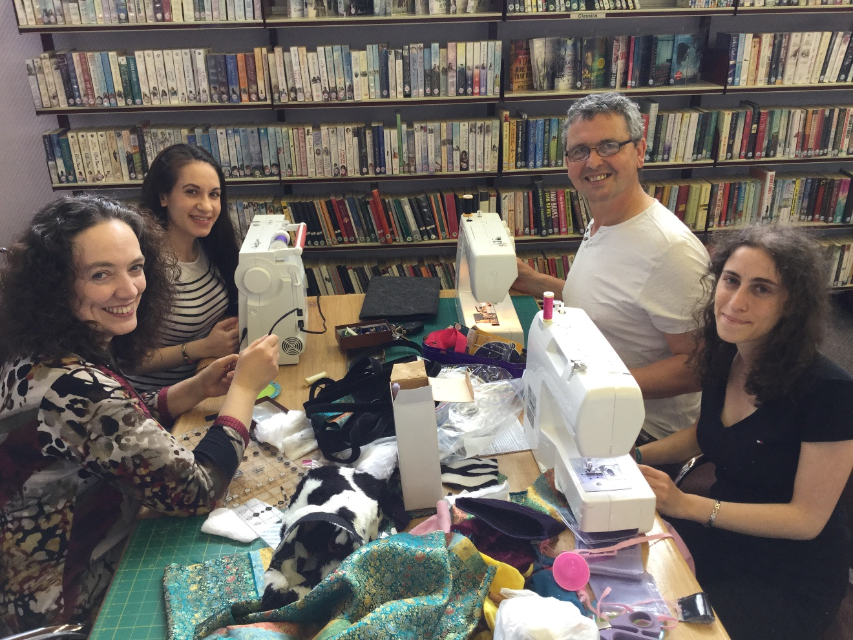
The Ethical Principles of Permaculture
Earth Care
People Care
Fair Share
Example: creating language games with recycled materials in a community repair cafe
More information: https://www.sprache-spiel-natur.de/tag/permakultur-einfuehrung/

Slide 7
Designing a Permaculture Sprachspinat-Garden
Some Permaculture design principles:
Every element fulfils several functions.
fostering language & education for sustainable development
learning about language & learning about nature
Every function is supported by several elements.
several plant lists for language activities
several plant lists for education for sustainable development
We use available resources.

Slide 8
Designing a Permaculture Sprachspinat-Garden
a toolkit for educational activities in any setting
private garden , school, community garden, living room etc.
3 plant lists for playful learning about language & nature
1 tutorial for a plant box with built-in worm compost "tower"
1 set of teaching materials and information about the 5 Rs:
Refuse, Reduce, Reuse, Recycle, Rot (= compost)

Slide 9
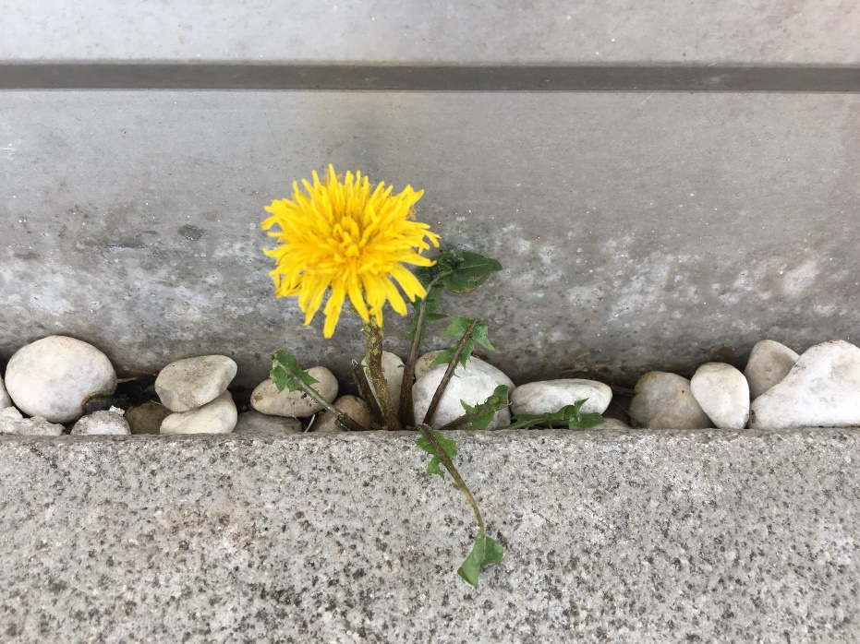
Wopf: A Word Plant List
plant names containing every-day words:
Frauen-mantel (Lady's mantle)
Löwen-zahn ("Lion's tooth" = dandelion)
aims:
buildung up the lexicon
learning about biodiversity & our relationship to nature

Slide 10
Wopf: Some Activities
selecting plants & planting
researching origin of plant names
search & find games in the garden
labeling plants
cross-linguistic comparisons
…

Slide 11
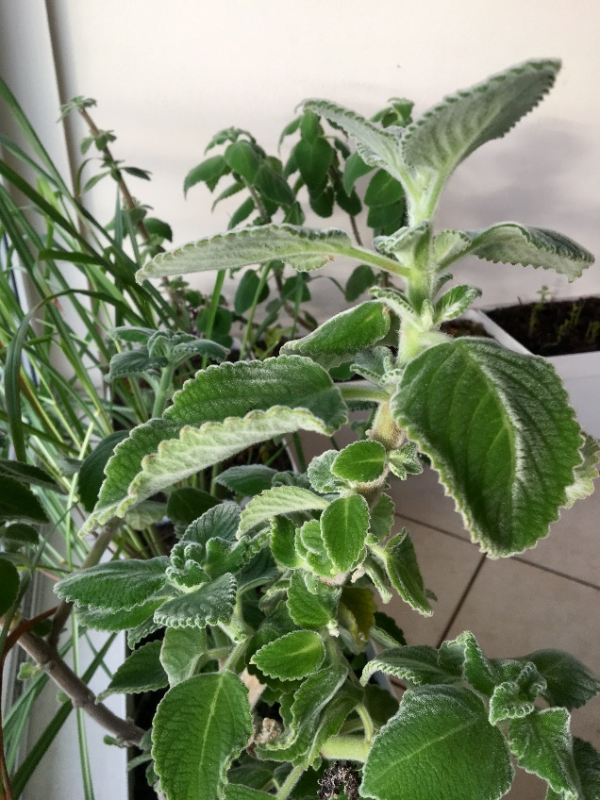
Wofopf: A Word Form Plant List
compound plant names involving:
Zitrone (lemon), Basilikum (basil), Minze (mint), Thymian (thyme),
Zitronenmelisse (lemon balm), Zitronen-Basilikum (lemon basil)
aims:
learning about word structure & creating new words
learning about biodiversity, food (miles)

Slide 12
Wofopf: Some Activities
sensory play
cooking
creating new names & finding out whether they exist already (licorice basil?)
swapping places within words (mint chocolate vs. chocolate mint)

Slide 13
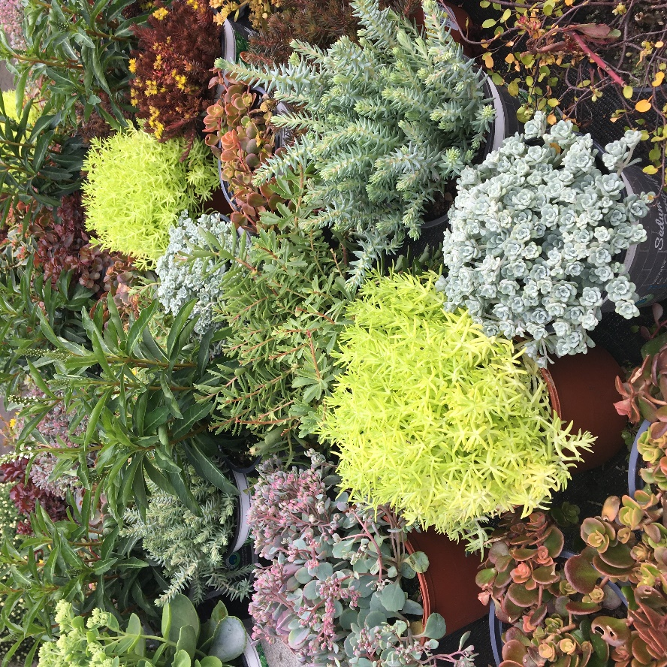
Wokopf: A Word-Combination Plant List
drought-resistant stonecrop plants (Crassulaceae)
Reichblühendes Fettblatt ("richly blooming fat leaf")
Weißblühender Rotmoos-Mauerpfeffer ("richly blooming red moss wall pepper)
aims:
learning about phrases and grammar
learning about our climate change and biodiversity

Slide 14
Wokopf: Some Activities
hide-and-seek toys in the garden with verbal instructions
sensory play
experimenting with watering systems
researching climate-adaptation of plants
fitting plants into botanical taxonomies (with gamification elements)

Slide 15
The Wupf - Worm Plant Box
a plant box with a built-in worm compost "tower"
aims:
learning to talk about space, time, color, size
learning about soil and the circle of life

Slide 16
Wupf: Some Activities
building a plant box
building a worm compost "tower"
planting up the box
"decorating" the box
discussing soil and the circle of life

Slide 17
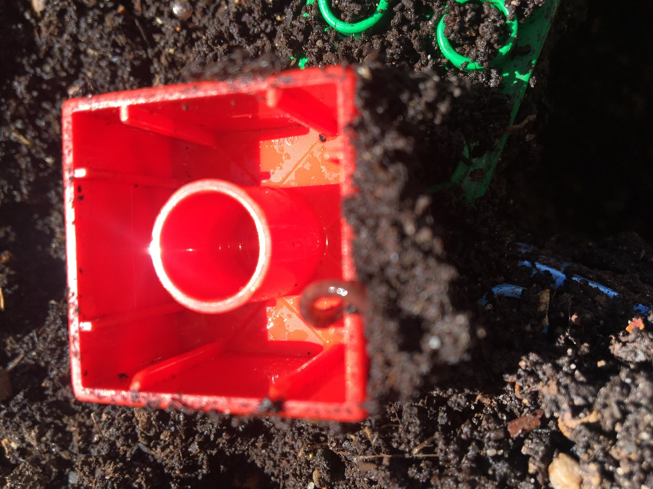
The 5 R Box: Information about Sustainability
The 5 Rs:
Reduce
Reuse
Recycle
Rot (compost)
aims:
learning to use (modal) auxiliaries
learning about sustainable production and consumption

Slide 18
The 5 R Box: Some Activities
Discussing the 5 Rs and what one could/should/must (not) do …
applying the 5 Rs:
indoors
in the garden
when creating the Wupf-box

Slide 19
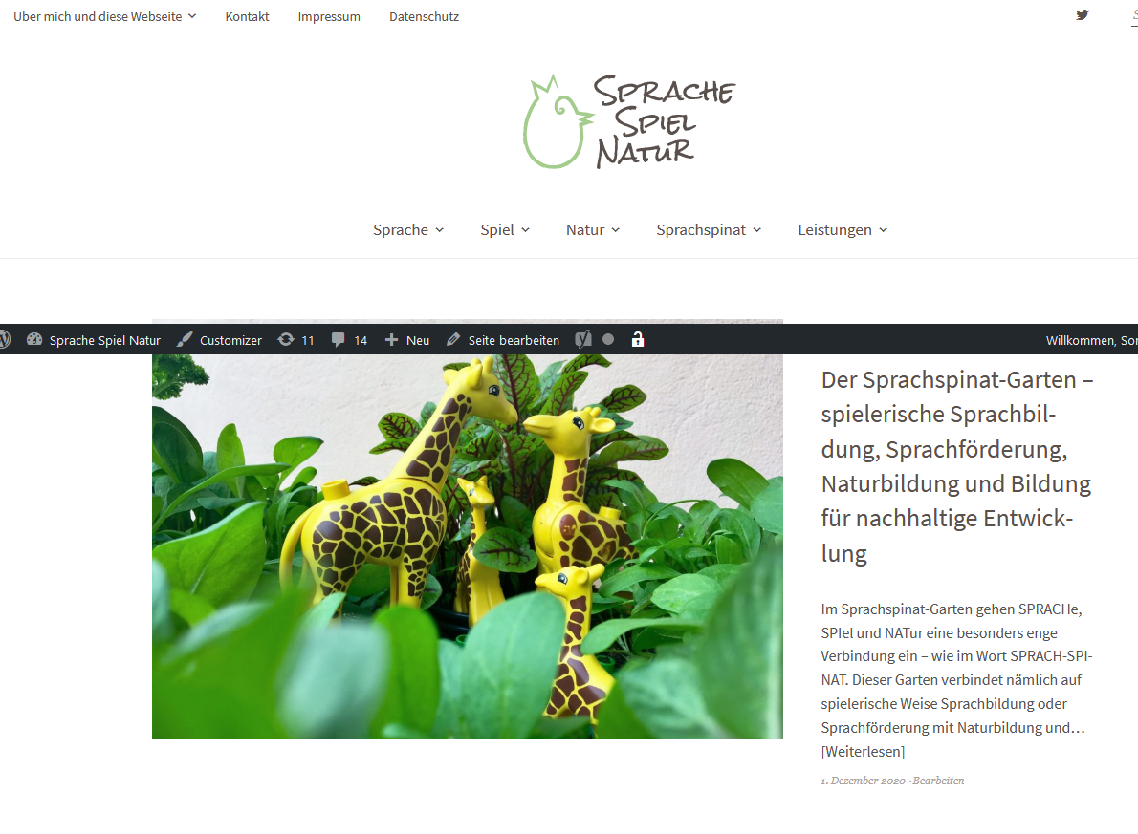
Find out more
Sprachspinat web page: https://www.sprache-spiel-natur.de/
articles in German
link lists in German & English
reading lists in German & English

Slide 20
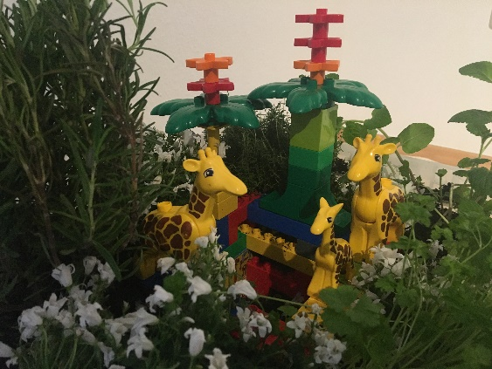
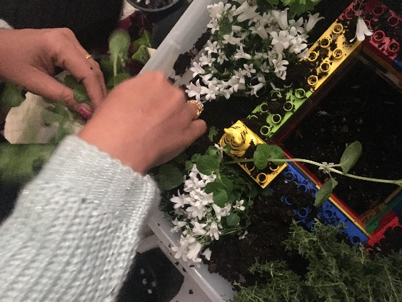
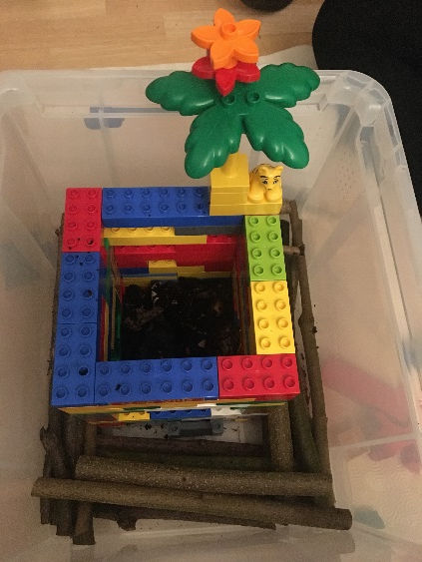
Get Started: Build a Wupf-Box
https://www.sprache-spiel-natur.de/wp-content/uploads/2019/11/Wurm_im_Turm_VHS_2019_11_27_final.pdf
Instructions in German, but with pictures

