Slide 1
Of language spinach and other word delicacies: gardening and communication
Sonja Eisenbeiß, die Sprachspinatin

Slide 2
Today's Take on "Unusual Language Acquisition"
Fostering language acquisition and education about language in an unusal way:
playful
in natural settings
while learning about nature
combined with education for sustainable development
Of course, an unusual approach requires an unusal name ….

Slide 3
Language Spinach?
+
+
Sprache
Spiel
Natur
+
+
Language
Play
Nature

Slide 4
Language Spinach?
+
+
=
SPRACHe
SPIel
NATur
Sprachspinat
+
+
=
Language
Play
Nature
Language Spinach
It is green and makes your language grow stronger …
… just like spinach made Popeye's muscles grow stronger

Slide 5
Permaculture: Designing Permanent Systems
stable & resilient
based on nature
in all areas of life:
agriculture
gardening
society
finances

Slide 6
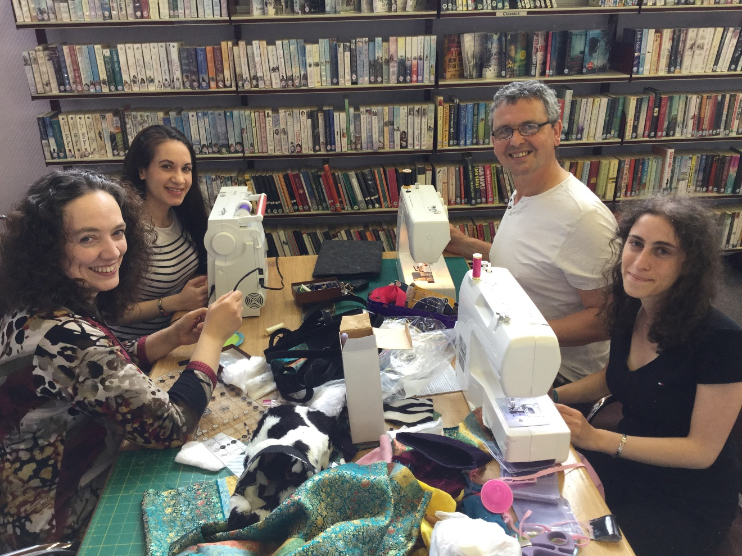
The Ethical Principles of Permaculture
Earth Care
People Care
Fair Share
Example: creating language games with recycled materials in a community repair cafe
More information: https://www.sprache-spiel-natur.de/tag/permakultur-einfuehrung/

Slide 7
Designing a Permaculture Sprachspinat-Garden
Some Permaculture design principles:
Every element fulfils several functions.
fostering language & education for sustainable development
learning about language & learning about nature
Every function is supported by several elements.
several plant lists for language activities
several plant lists for education for sustainable development
We use available resources.

Slide 8
Designing a Permaculture Sprachspinat-Garden
a toolkit for educational activities in any setting
private garden , school, community garden, living room etc.
3 plant lists for playful learning about language & nature
1 tutorial for a plant box with built-in worm compost "tower"
1 set of teaching materials and information about the 5 Rs:
Refuse, Reduce, Reuse, Recycle, Rot (= compost)

